Slide 1
Types of data and describing data with summary statistics
data science for biologists
stephanie j. spielman, PhD

Slide 2
Pop quiz: Is it random?
A researcher selects the first 58 student volunteers that sign up for a study
A computer program numbers all residents in a community, and then uses a random-number generator to select 26 residents
A researcher vigorously shakes a box containing equally sized balls and takes the first 3 that fall out of the box.
A researcher selects all study participants whose first name starts with an A, B, K, M, or O.

Slide 3
Types of data
How you analyze and visualize data depends on the type of data you have
Quantitative data
Continuous
Discrete (includes count data)
Categorical data
Nominal
Ordinal
Binary*
Human data type | R data type
Quantitative continuous | Numeric (double)
Quantitative discrete | Numeric (integer)
Categorical nominal | Character or factor
Categorical ordinal | Factor
Categorical binary | Factor or logical

Slide 4
Quantitative data
Continuous
Any real-number value within some range
Discrete
Values are in indivisible units, i.e. whole or counting numbers
Includes count data (number of cups of coffee per day, number of amino acids in a protein…)

Slide 5
Categorical data
Nominal
Hair color, eye color, sex genotypes (XX, XY, XXY, XYY, XO, …)
Ordinal – categories with a natural ordering
Bad, fair, good, excellent
A, B, C, D
Binary
Yes/No
True/False

Slide 6
Data types translated
Human data type | R data type
Quantitative continuous | Numeric (double)
Quantitative discrete | Numeric (integer)
Categorical nominal | Character or factor
Categorical ordinal | Factor
Categorical binary | Factor or logical

Slide 7
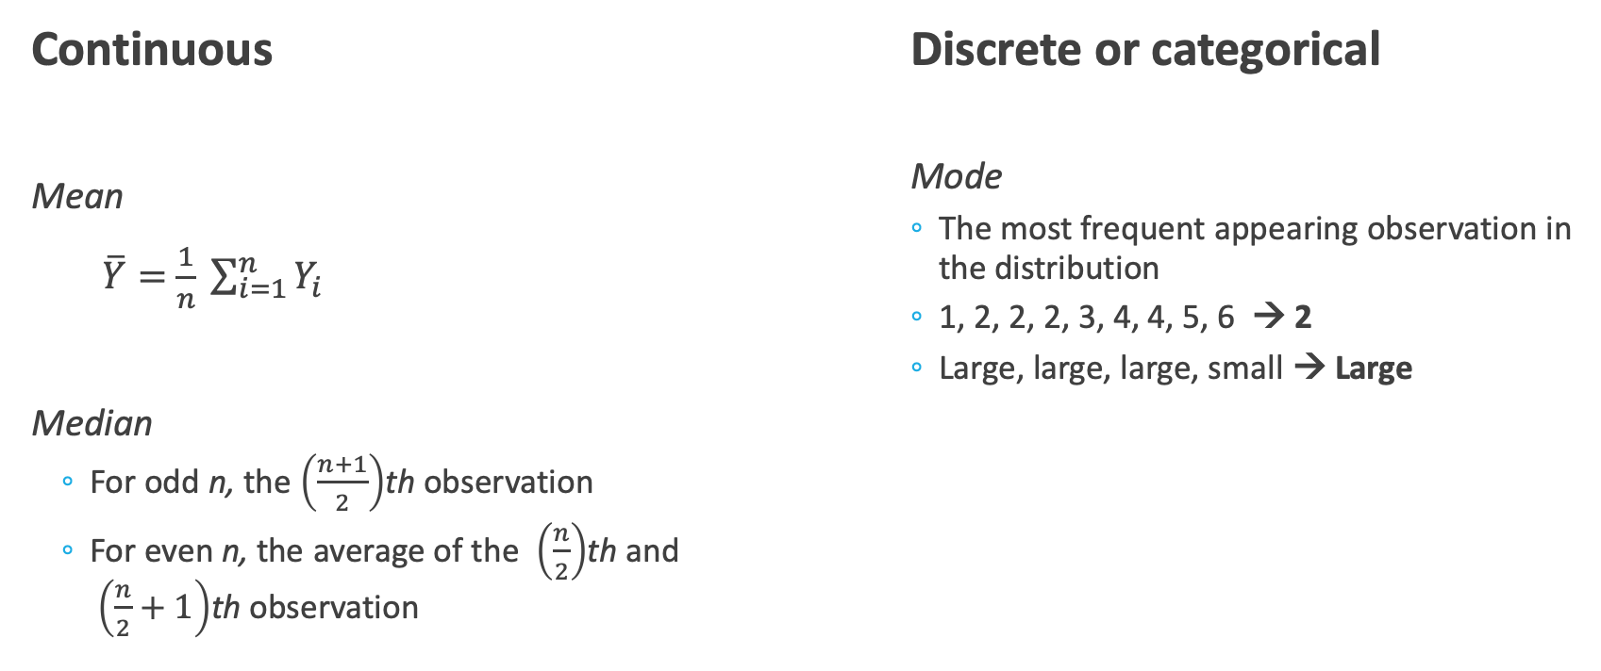
Measures of Location
Continuous
Mean
$\overline{Y}=$ $\frac{1}{n} \sum_{i=1}^{n}{Y_{i}}$
Median
For odd n, the $\left(\frac{n+1}{2}\right)$th observation
For even n, the average of the $\left(\frac{n}{2}\right)$th and $\left(\frac{n}{2}+1\right)$th observation
Discrete or categorical
Mode
The most frequent appearing observation in the distribution
1, 2, 2, 2, 3, 4, 4, 5, 6 → 2
Large, large, large, small → Large

Slide 8
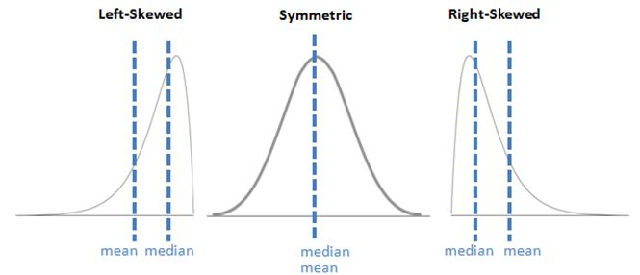
Measures of location in distributions
http://i.imgur.com/YSEYhha.jpg

Slide 9
Measures of spread
Range
Standard deviation and variance
Interquartile range

Slide 10
Range
Difference between largest and smallest value in a distribution
1, 2, 3, 7, 9 → 8
1, 2, 3, 7, 9, 500 → 499
Range is very sensitive to extreme observations and becomes very unwieldy very quickly.

Slide 11
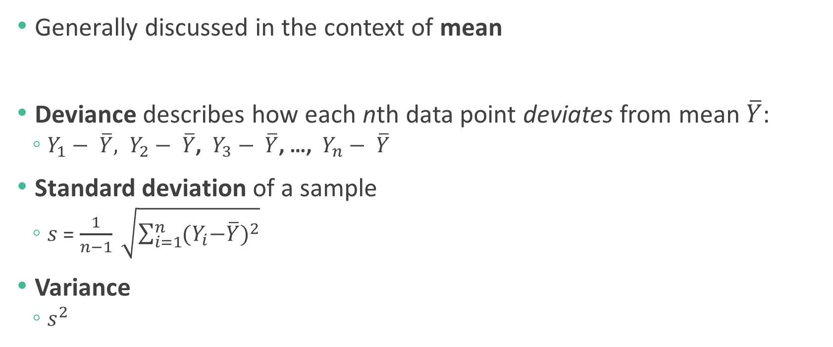
Standard deviation and variance
Generally discussed in the context of mean
Deviance describes how each nth data point deviates from mean $\overline{Y}$:
$Y_{1}− \overline{Y}, Y_{2}− \overline{Y}$, $Y_{3}− \overline{Y}$, …, $Y_{n}− \overline{Y}$
Standard deviation of a sample
$s$ = $\frac{1}{n−1} \sqrt{\sum_{i=1}^{n}{{{(Y}_{i}−\overline{Y})}^{2}}}$
Variance
$s^{2}$

Slide 12
Interquartile range
Generally discussed in the context of median
Quartiles divide the data into four equal parts (“quar”!)
Interquartile range (IQR) is the difference between the third and first quartile
How much of the data does the IQR encompass?
Five number summary: min, Q1, median, Q3, max

Slide 13
Mean or median?
The median is much more robust to outliers compared to the mean.

Slide 14

Measures of variability
Coefficient of variation is the standard deviation of a sample expressed as a percentage of the sample mean (aka normalized)
$COV= \frac{s}{\overline{Y}}×100\%$
Useful measure for comparing variability between two differently-scaled datasets

Slide 15
Visualizing data
Different types of plots are used to represent different types of data
Continuous data
Histogram
Density plot
Boxplot
Violin plot
Discrete data
Bar plot
Comparing two continuous variables
Scatterplot
Trend over time
Line plot

Slide 16
“Directory of data visualizations” (ch5)

Slide 17
Histogram

Slide 18
Using histograms to describe distributions

Slide 19
Density plots smoothen histograms

Slide 20
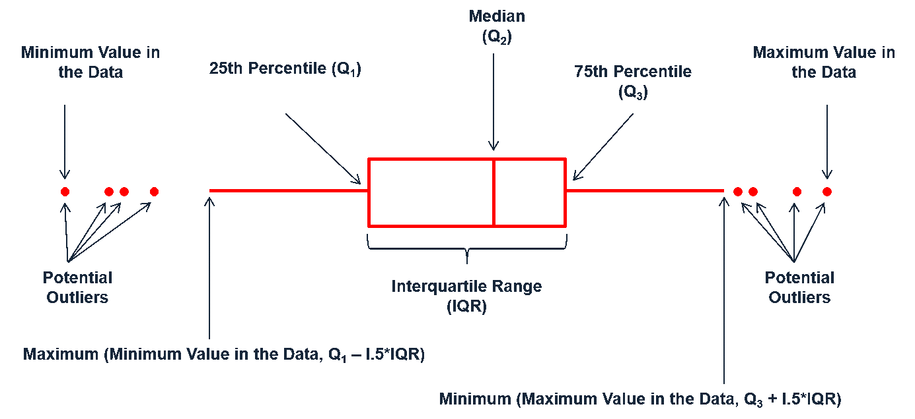
Boxplot
Graphical representation of a five-number summary
“Whiskers” calculated as data within +/- 1.5 IQR
“whiskers”
Q3
Median
IQR
Q1
outliers

Slide 21
Boxplots: The plot thickens*
*Pun intended.
Notes:
So why are there outliers in one and not the other?

Slide 22
What can we say about this distribution based on its boxplot?
Symmetry?
Skewness?
Modality?
Asymmetric
Right-skewed
Unclear
Notes:
Mean vs median, symmetric or asym, is it unimodal?

Slide 23
Visualizing amounts/proportions
“dodged” = grouped

Slide 24
Barplot

Slide 25
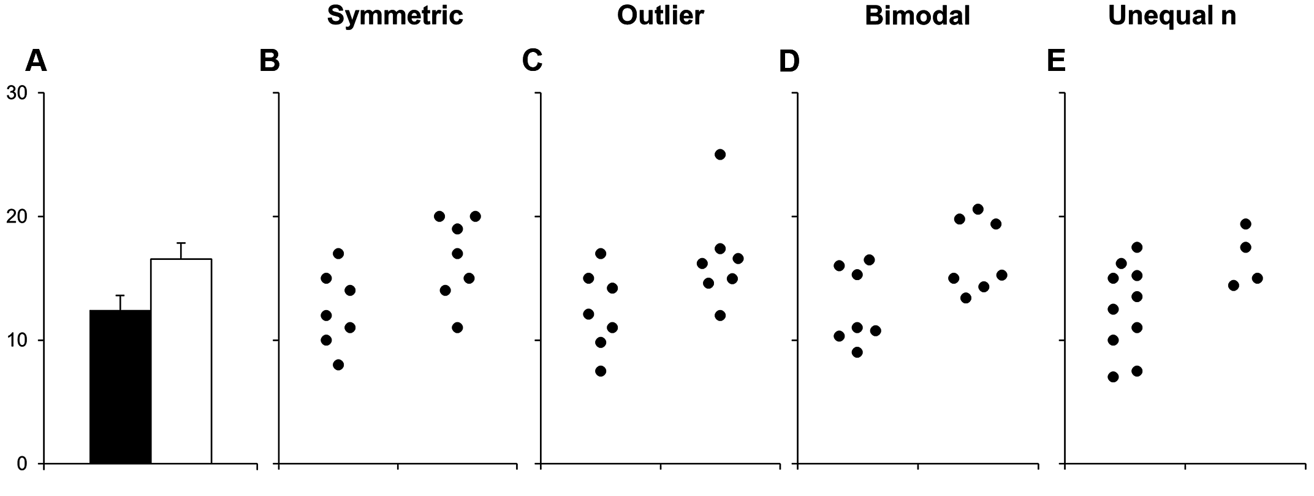
Cautionary tale in barplots
http://journals.plos.org/plosbiology/article?id=10.1371/journal.pbio.1002128

Slide 26
Scatterplot
response/dependent variable
explanatory/independent variable

Slide 27
Time series data

